Slide 1


FOX MODEL YEAR 2019 LIVE VALVE OE/AM UPDATE

Slide 2
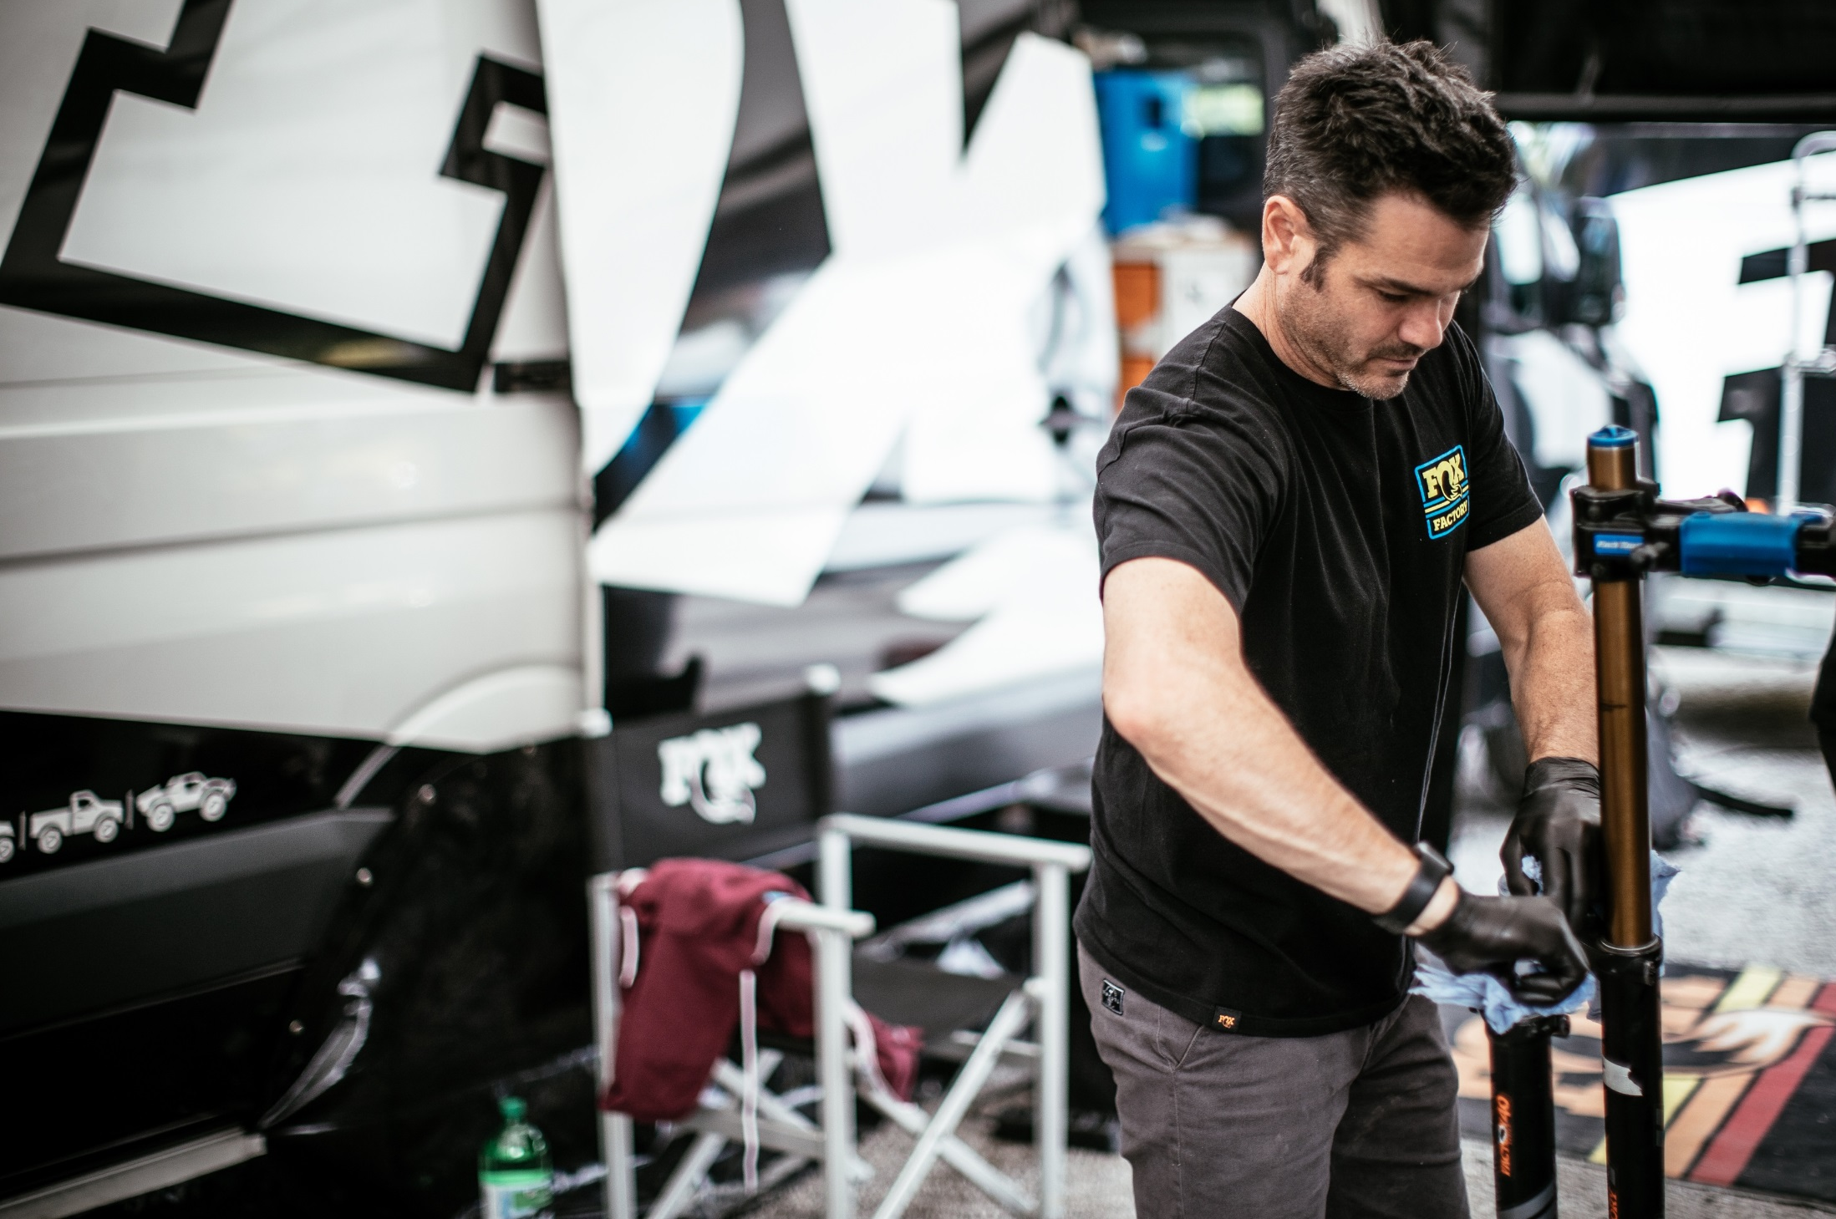

LIVE VALVE EMBARGO
REVISED EMBARGO DATE
AUGUST 28, 2019
DO NOT SHARE ANY LIVE VALVE INFORMATION UNTIL THEN !

Slide 3
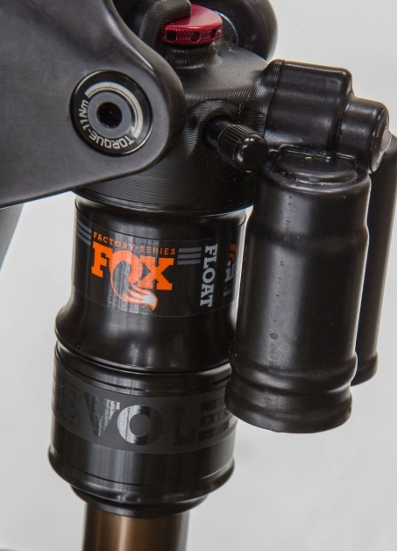
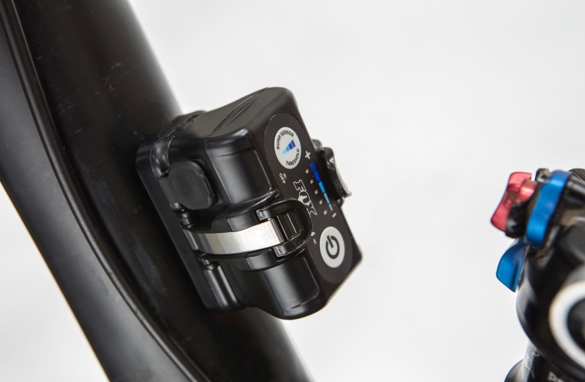
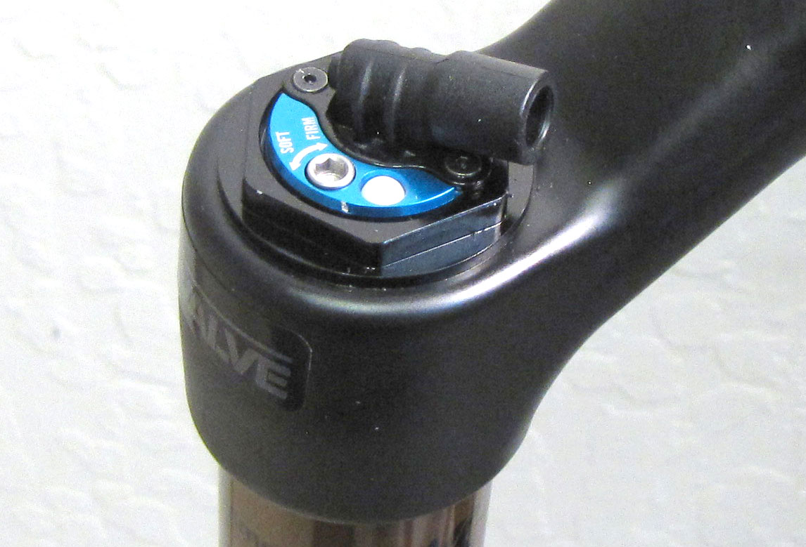
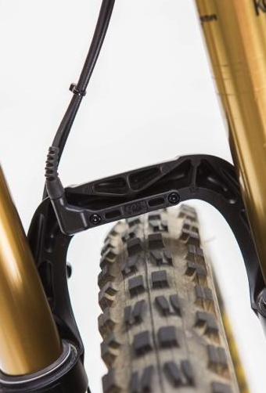
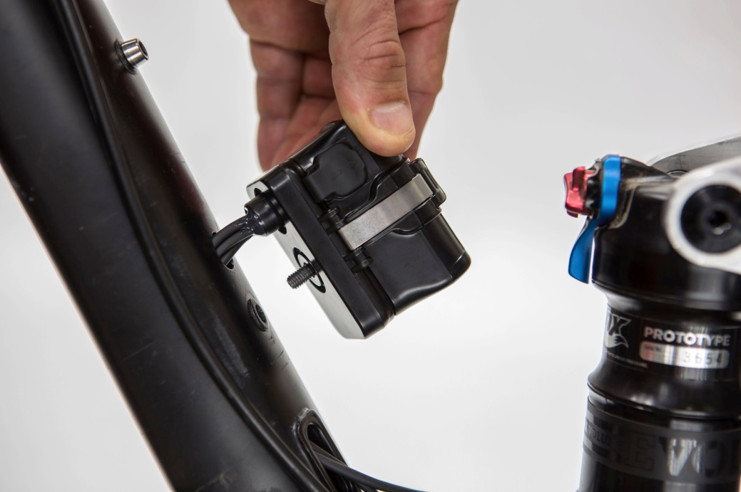
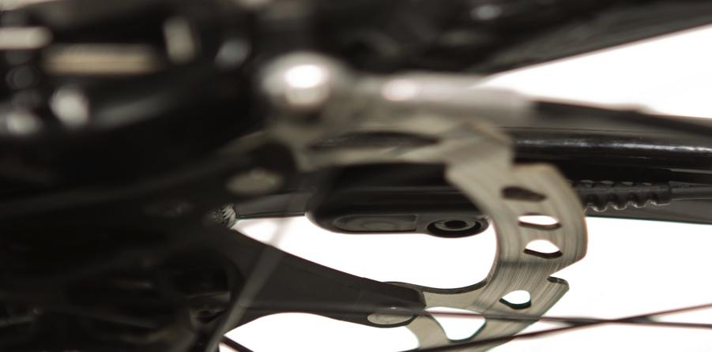
LIVE VALVE
Electronic suspension control system
Reads terrain input through accelerometers and changes
damping modes instantaneously
Maximizes efficiency – suspension in the most favorable mode automatically and all the time
FAST! Reaction time 3-5 milliseconds
100x faster than the blink of an eye
Fast enough to sense and react at the same wheel
Fast enough that you can’t feel the
first strike of the bump
Production-ready for MY19!
UNDER EMBARGO UNTIL 8am PDT AUGUST 28, 2018

Slide 4
LIVE VALVE
Patented latching solenoid
Fast, quiet, power efficient – uses power only to switch position
Small size/packaging enables fitment in shocks and forks
Controller and accelerometers
Internal routing only
Controller orientation important
System automatically selects between open and firm damping based on bump input
Rider adjustable G-threshold
Freefall mode 25ms
Front accelerometer opens fork and shock; rear accelerometer opens shock
Tunes for XC to Enduro and EMTB
UNDER EMBARGO UNTIL 8am PDT AUGUST 28, 2018

Slide 5
LIVE VALVE
AM – OPPORTUNITY!
List of bikes that are already in the market and LIVE VALVE ready:
Giant
Anthem Advanced Pro 29
Reign Advanced 27.5
Scott
Spark
Genius
Pivot
Mach 5.5
Rocky Mountain
Altitude Carbon
Instinct Carbon
Thunderbolt Carbon
UNDER EMBARGO UNTIL 8am PDT AUGUST 28, 2018

Slide 6
LIVE VALVE
Production Timing
OE INITIAL SHIPMENTS
Pivot Mach 5.5: August 19th - 20 units
Scott Genius: August 27th – 100 units
Giant Anthem Advanced Pro 29: August 27th – 125 units
AM, First Shipments November
Scott Spark
Scott Genius
Pivot Mach 5.5
Rocky Mountain Altitude
Rocky Mountain Instinct
Rocky Mountain Thunderbolt
Giant Anthem Advanced Pro 29
Giant Reign Advanced 27.5
**AM kits contain fork, shock, and all Live components**
UNDER EMBARGO UNTIL 8am PDT AUGUST 28, 2018

Slide 7

THANK YOU

